Slide 1

Ai Project

Slide 2
Introduction to AI
Explore the definition and overview of Artificial Intelligence. Learn about the importance and challenges of creating a fruit and vegetable recognition software using AI techniques.

Slide 3
Fruit and Vegetable Recognition Software
1
Importance
The purpose of the system is to minimize the number of human computer interactions, speed up the identification process and improve the usability of the graphical user interface compared to existing manual systems.
Challenges
2
Stability of fast recognition under complex background interference, stability of recognition under different lighting environments for the same crop, the reliance of recognition and localization on prior information in the presence of fruit overlap and occlusions caused by leaves and branches, and the uncertainty of picking caused by complex working environments.
3
Techniques
Is based on machine vision, which refers to the combination of computational algorithms and image Information.
Algorithm
4
Dive into the algorithm used to train and identify fruits and vegetables in the recognition software.
(EXPLAINED FURTHER BELOW)

Slide 4
Algorithm
Import necessary libraries:
Import NumPy and TensorFlow
Import ImageDataGenerator from TensorFlow Keras for image preprocessing
Set up data augmentation and normalization for training:
Define train_datagen with specified augmentation techniques
Define test_datagen for test data normalization
Load and preprocess the data:
Use train_datagen.flow_from_directory() to create a train data generator
Use test_datagen.flow_from_directory() to create a test data generator
Create a simple CNN model using TensorFlow Keras Sequential API:
Sequential model with Conv2D, MaxPooling2D, Flatten, and Dense layers
Define the architecture of the CNN model
Compile the model:
Compile the model with specified optimizer, loss function, and evaluation metrics
Train the model:
Use model.fit() to train the model with training and validation data generators
Specify the number of epochs and steps per epoch for training
Visualize training history:
Plot accuracy and loss graphs for the training and validation datasets using Matplotlib

Slide 5

AI Project Steps
1
Data Collection and Preprocessing
Learn about the crucial step of collecting and preparing the data for training the AI model.
2
Model Development and Training
Discover the process of building and training the AI model to recognize fruits and vegetables accurately.
3
Evaluation and Deployment
Explore the methods used to evaluate and assess the performance of the AI model before deploying it.

Slide 6
1. Data Collection and Preprocessing
Data collection: The first step is to collect a large and diverse dataset of fruit and vegetable images. The images should cover different types of fruits and vegetables, such as apples, bananas, oranges, tomatoes, etc. The images should also capture various aspects of the fruits and vegetables, such as shape, size, color, texture, ripeness, defects, etc. The images should be taken from different angles, distances, and lighting conditions to increase the robustness of the recognition system.
Data preprocessing: The second step is to preprocess the collected images to make them suitable for the recognition system.

Slide 7
2.Model Development and Training
Model building: This involves choosing a suitable neural network architecture, such as a convolutional neural network (CNN), a residual network (ResNet), a VGG network, or a MobileNet, and defining the layers, parameters, and hyperparameters of the network. The network should have an input layer that accepts the preprocessed images, several hidden layers that extract features from the images, and an output layer that predicts the labels of the fruits and vegetables.
Model training: This involves feeding the preprocessed images and their labels to the neural network and adjusting the network weights using an optimization algorithm, such as stochastic gradient descent (SGD), Adam, or RMSprop, and a loss function, such as cross-entropy, mean squared error (MSE), or focal loss. The network should be trained on a subset of the data, called the training set, and evaluated on another subset, called the validation set, to monitor the performance and avoid overfitting or underfitting.

Slide 8
3.Evaluation and Deployment
Some of the challenges and issues that may arise during the deployment of a fruit and vegetable recognition software are:
The quality and quantity of the data
The diversity and complexity of the fruits and vegetables
The accuracy and robustness of the model
The speed and scalability of the system
The security and privacy of the data and the model

Slide 9

Code Implementation
View the code snippets for implementing the fruit and vegetable recognition software algorithm.

Slide 10

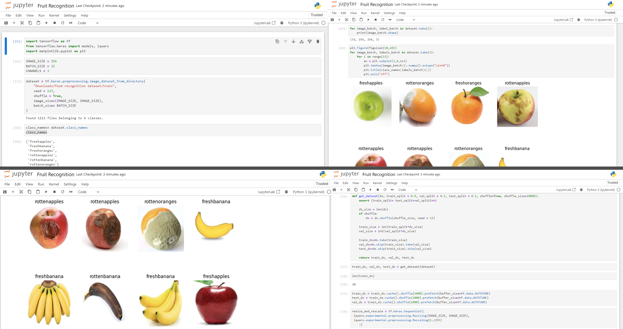

Slide 11

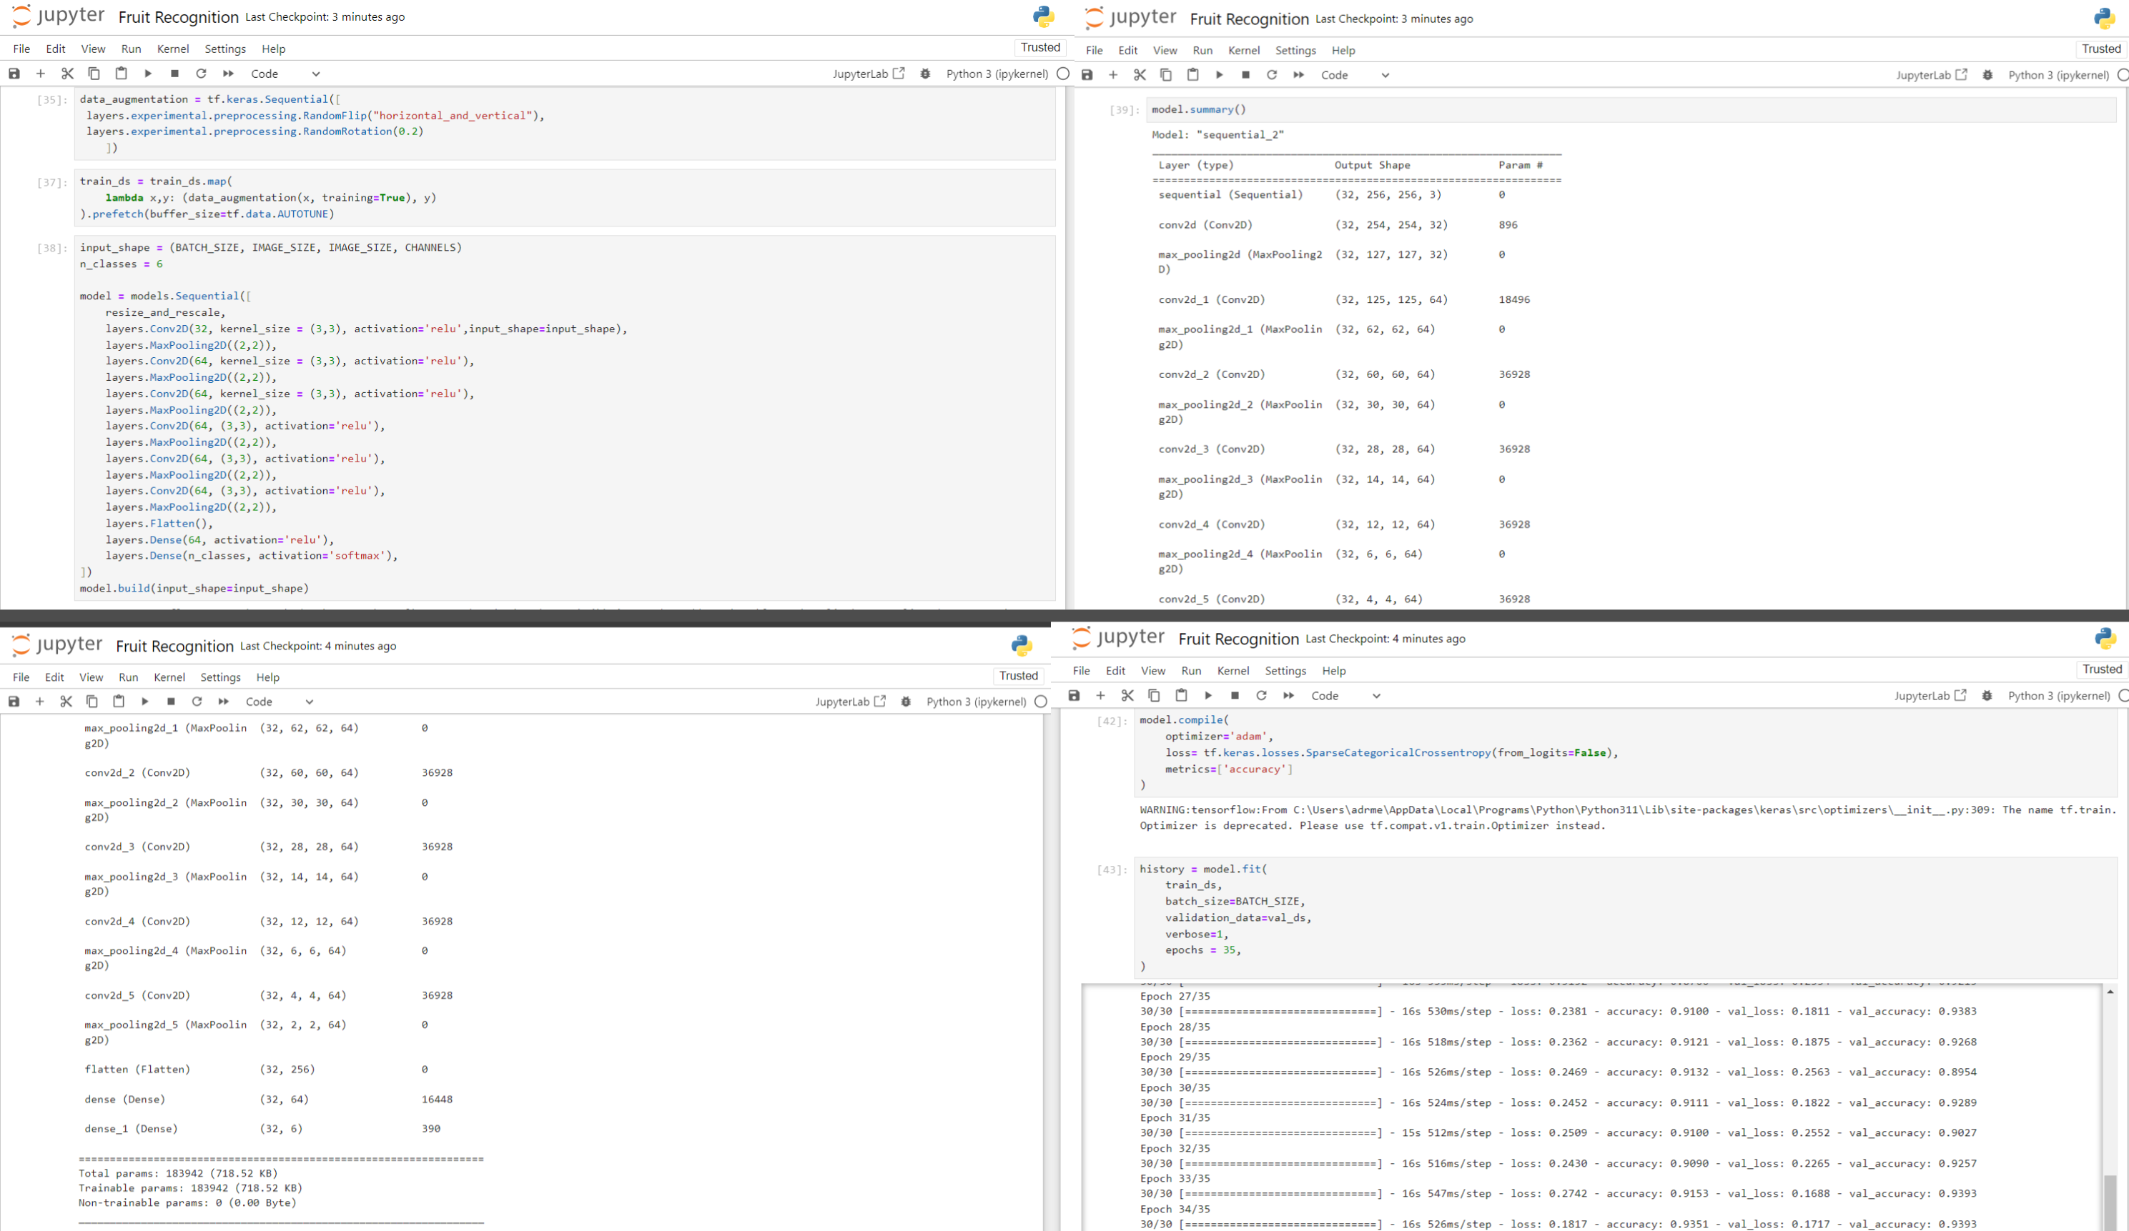

Slide 12

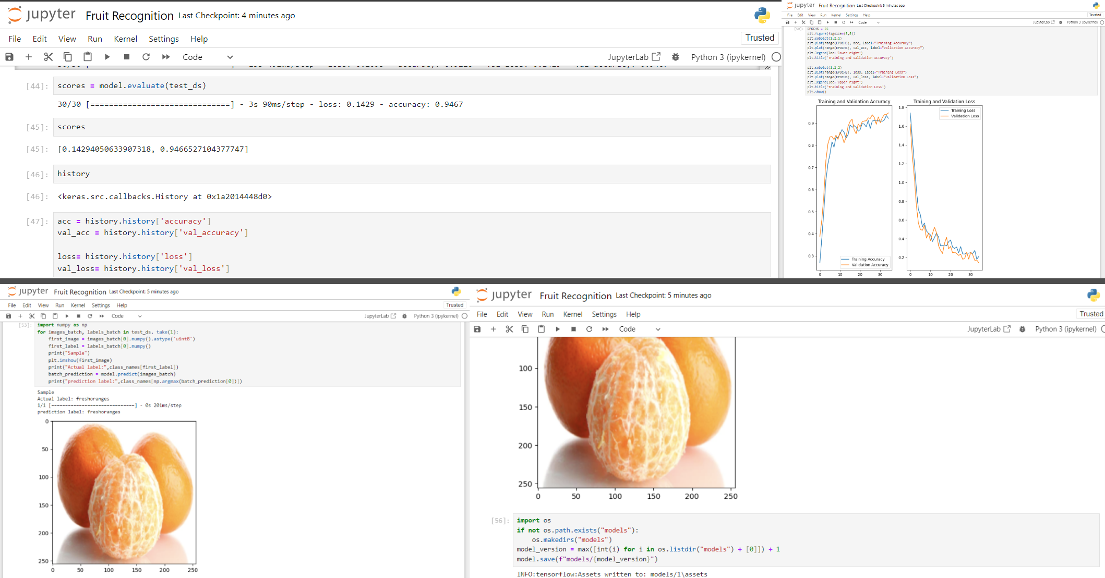

Slide 13

Conclusion
1
Recap of Key Points
2
Importance of AI
3
Future Possibilities
Summarize the key concepts learned throughout the presentation.
Understand the significance of AI in shaping the future and driving innovation.
Explore the potential developments and possibilities in the field of AI and fruit and vegetable recognition.

